Slide 1
Austin Police Shootings
Team Macro
Andrew Adelson
Christian Harris
Justin Ma

Slide 2
Zip Code NLP Clustering
Webscraped two sources for demographic and census data
Claritas Zip Code Look Up
Zipwho.com
Clustered on 37 traits, including:
Income
Population
Urbanicity
Family Characteristics
Level of Education
Employment
Age
Standardized each column and applied K Means clustering to create 5 types of zips.

Slide 3
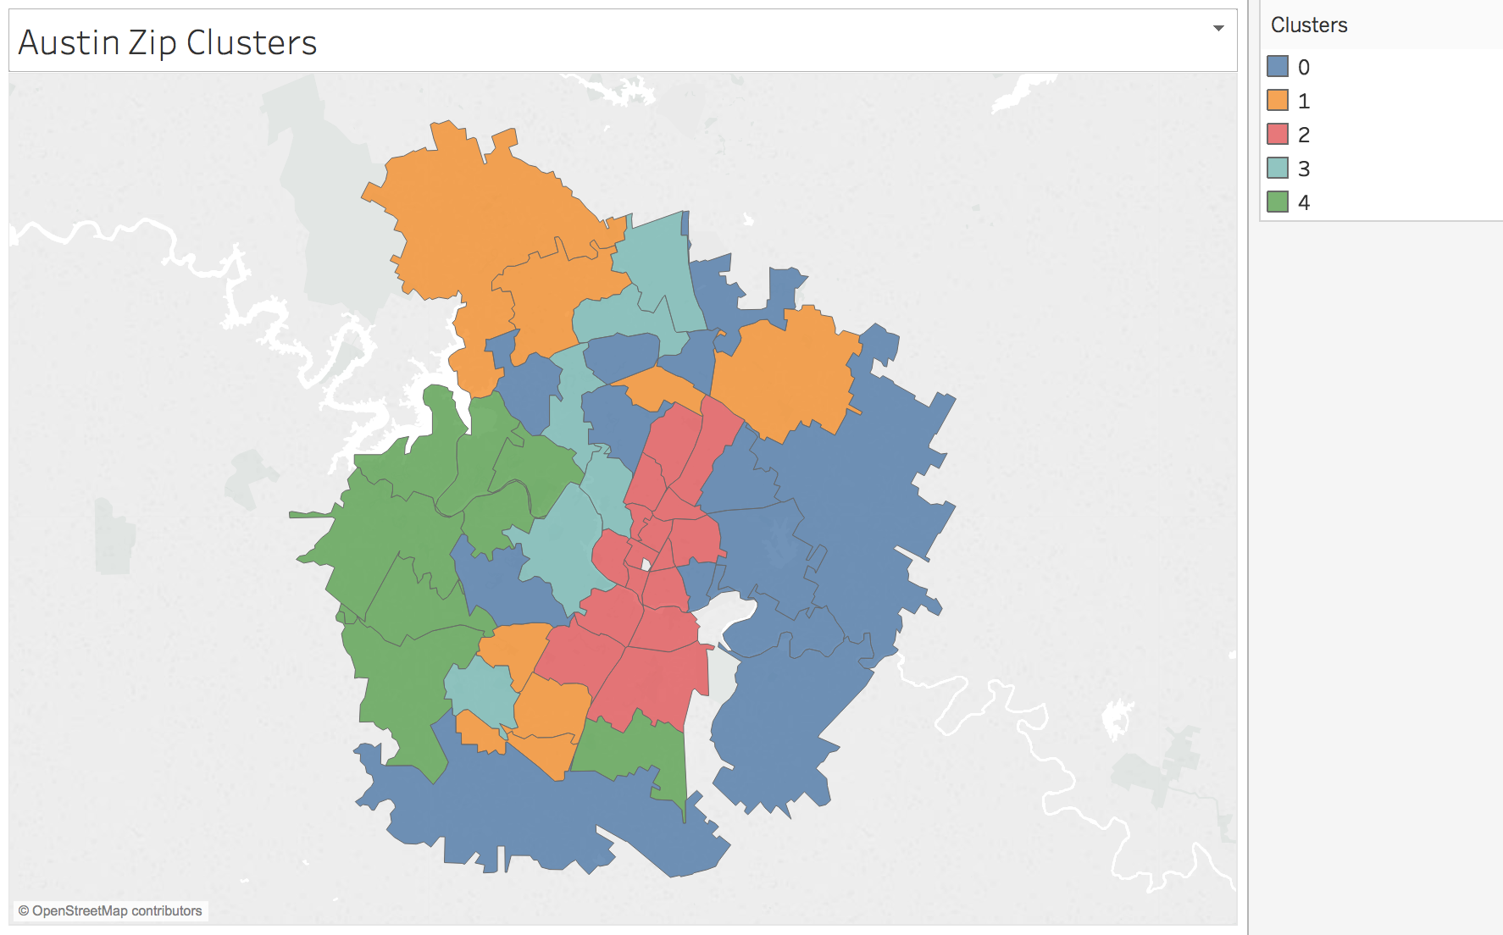
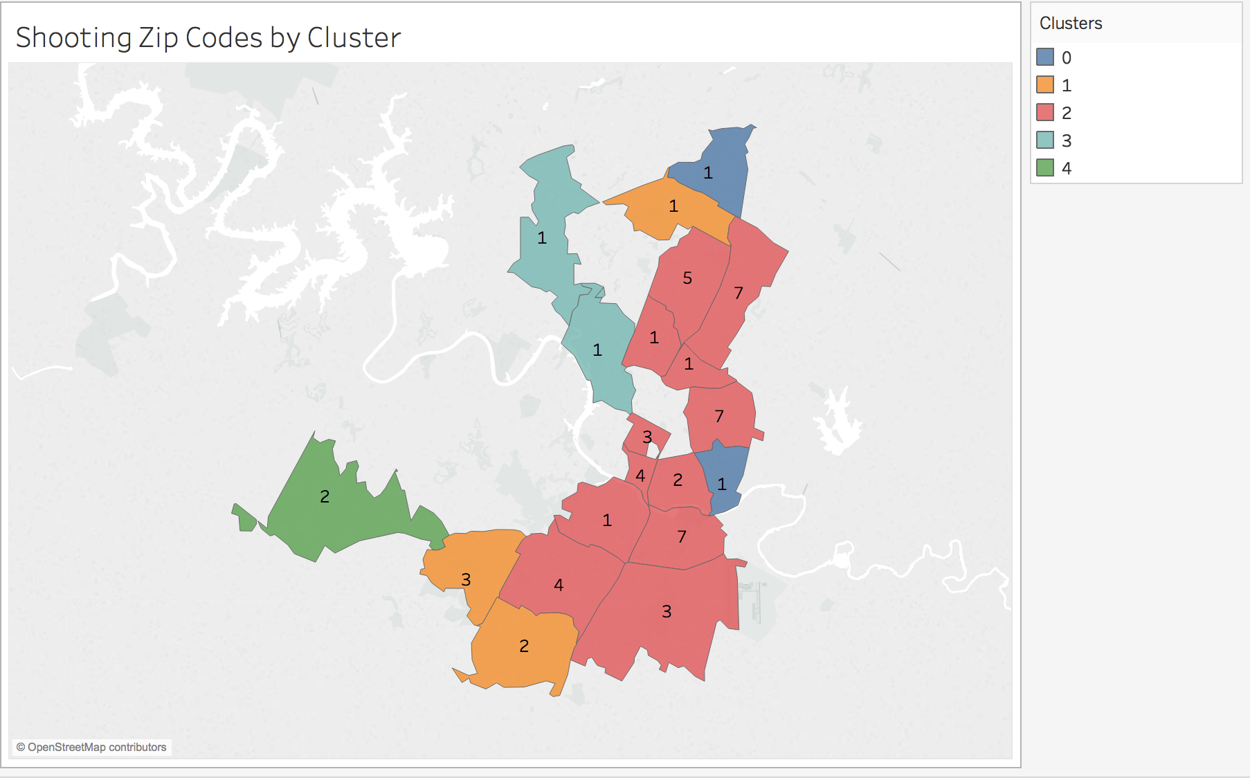
Zip Code Clusters

Slide 4
Target Cluster
The “worst” cluster contained 12 zips, accounting for ~40% of Austin’s population.
This cluster accounted for 77% of the shootings
This cluster accounted for ~76% of the Austin PD emergency calls
The cluster contains the following zips:
78745, 78758, 78704, 78723, 78744, 78753, 78705, 78701, 78702, 78741, 78752, 78757
Target Cluster Traits:
Median income - $35k (compared to $60k overall in Austin)
Urban areas
Renter saturated (5th percentile in US for “owner occupied")

Slide 5
Zip Code Supervised Learning
Goal: Figure out which factors were the most predictive for number of shootings in a zip code from 2007-2016
Algorithm: Lasso Regression
Most predictive features:
Income: Lower Midscale
Population
Urbanicity: Urban
Housing: Renters
Median Household Income Percentile (negative correlation)

Slide 6
Product
Seminar/Webinar for stake-holders
APD officers
City Planners and Officials
Austin residents
Includes summary of findings and data visualizations
Built using fullPage.js framework and Bootstrap
Tablet and small screen responsive

